Slide 1
Prototype of our project
One-Stop-Solution

Slide 2
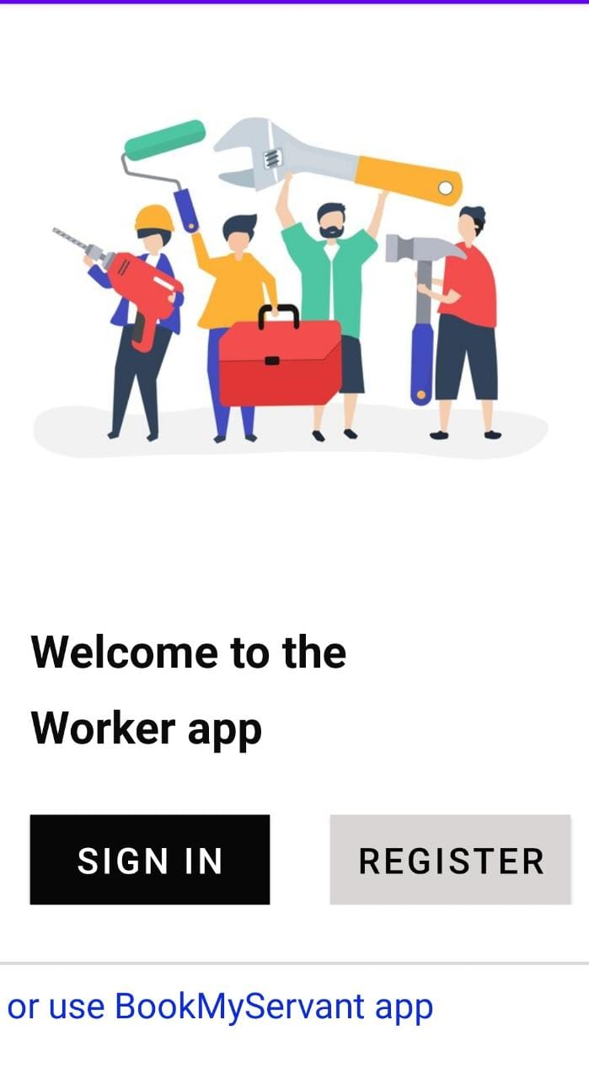
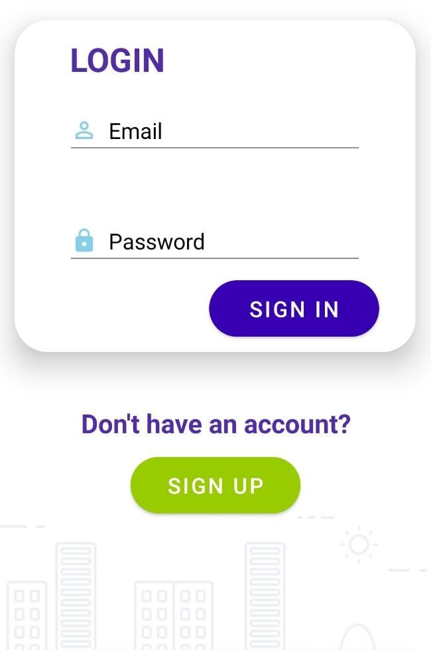
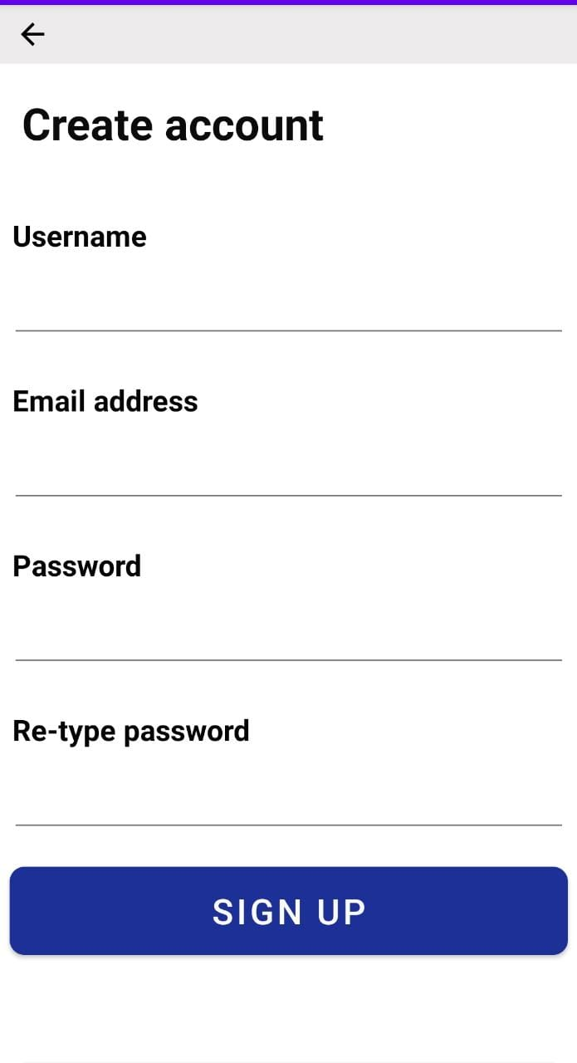
Workflows

Slide 3
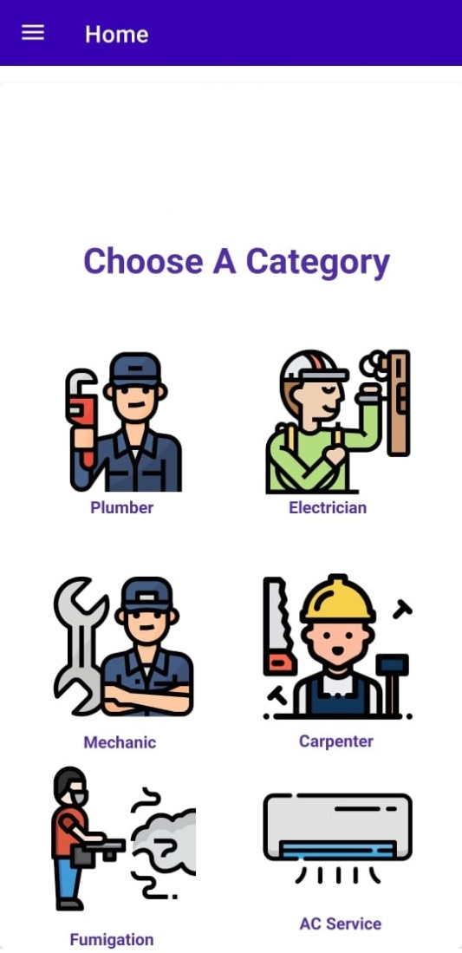
User actions
User will have a variety of choices which will show their desired solutions for their daily life problems.
One stop basically provides
different services at one page/web and shows the partnership element.

Slide 4
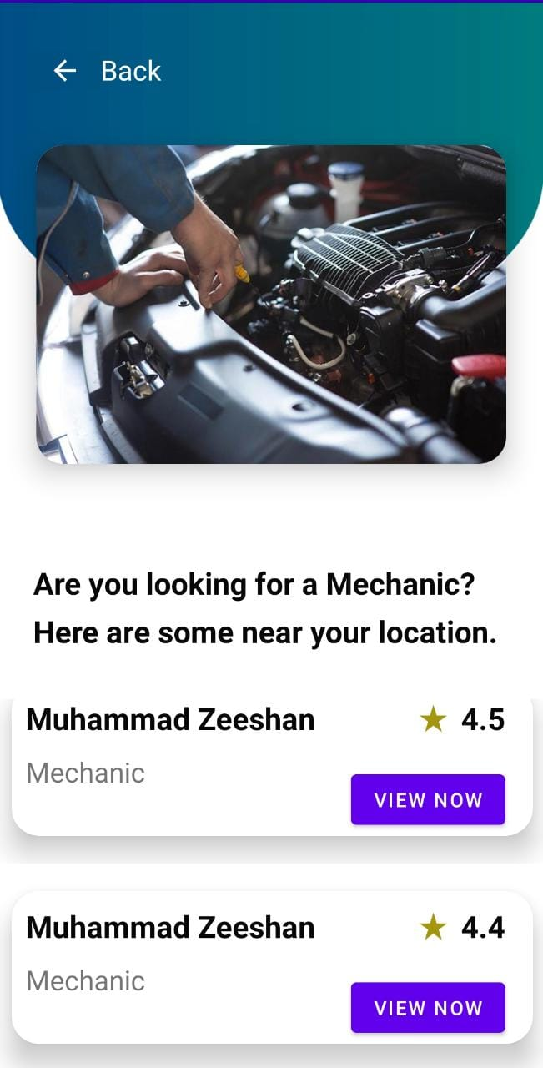
Mechanic page

Slide 5
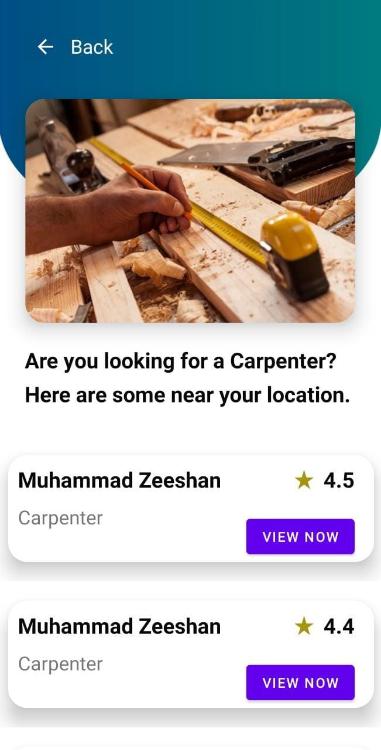
Carpenter page

Slide 6
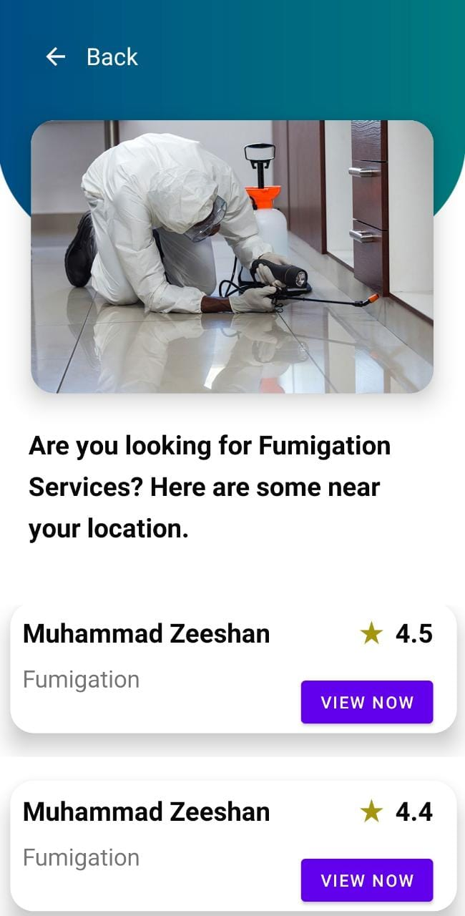
Fumigation page

Slide 7
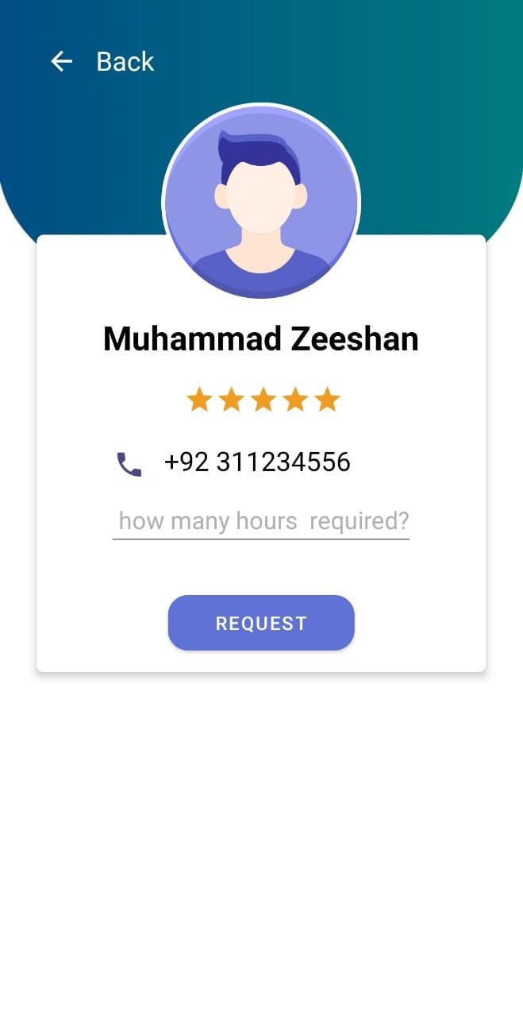
Any of the work fields, shown before, the user selects will be activated. For example, if the user selects any “plumber” worker, then the details of that worker are displayed

Slide 8
Payment methods
There are two ways to pay
Cash
&
Online payment

Slide 9
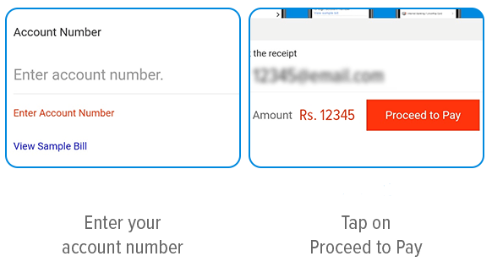
Online payment

Slide 10
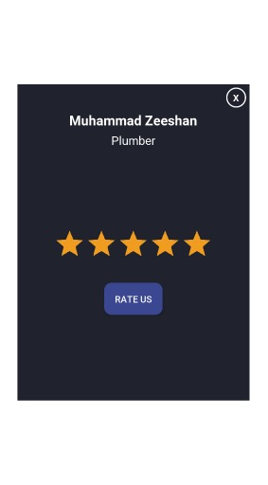
Finally, there will be a rating screen where users will be requested to rate their experiences

Slide 11

Worker actions
Our esteemed workers will also be able to perform certain actions based on different parameter. Some of the details are shown in the following slides

Slide 12
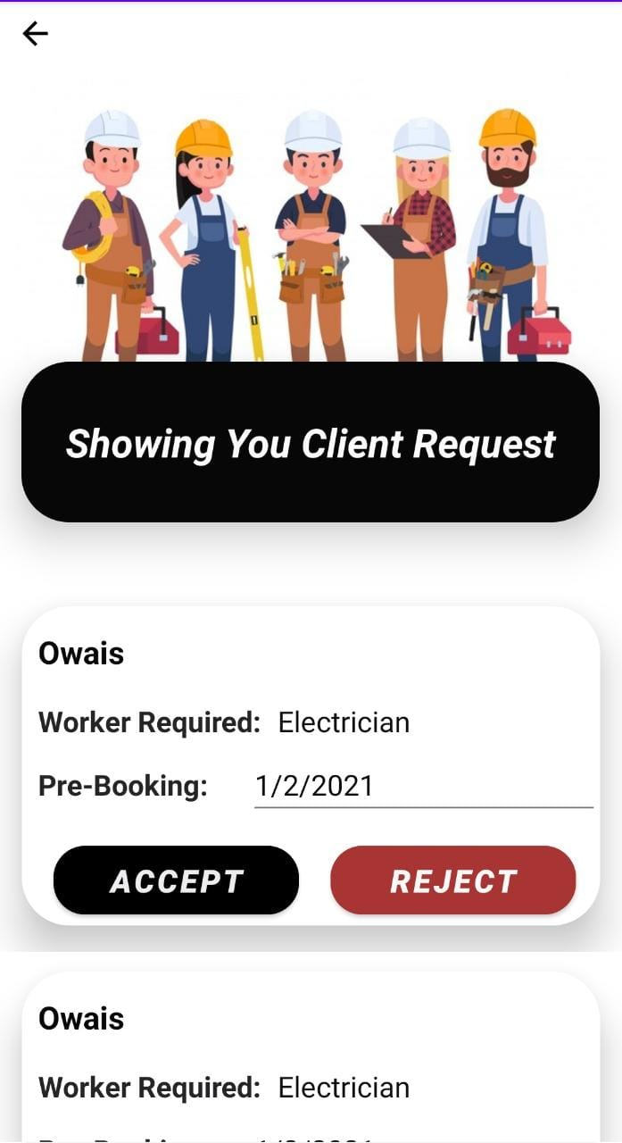
Status of Requests

Slide 13
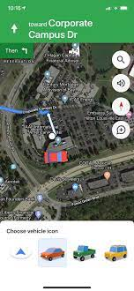
The work destination Workers will be able to reach their working areas by using Google maps services

Slide 14
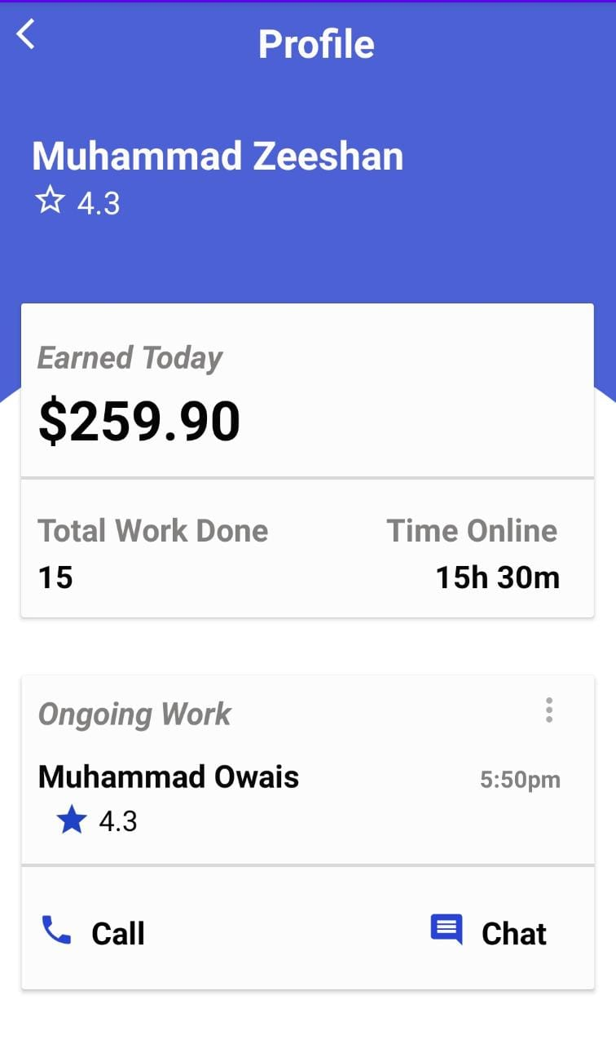
Financial profile

Slide 15
Thank you
Team members:
Laiba Zubair (20k-0258)
Wania Aslam (20k-1709)
Maham Adnan (20k-1699)

